Slide 1
PCG – Influence, representation and member services
John Brazier, Managing Director, PCG
European Medical Writers Association…Freelance Forum, Manchester, May 10, 2013

Slide 2
PCG: The voice of freelancing in the UK
Freelancers
Sole Traders
One Person Enterprises
Contractors
Self -Employed
Nano-businesses
Independents
Independent
Professionals
Notes:
UK – Freelancers
Australia – Contractors
Europe – Independents / One person enterprises
2

Slide 3
Growth in UK freelancing
  Recent research conducted by Kingston University for PCG shows:
  There are 1.56 million freelancers in the UK
  Figures show a 12% growth in freelancing over three years. The current number of freelancers is up from the previous figure of 1.39 million in 2008
  There has been a 25% rise in ‘working mother’ freelancers over the last three years
  One fifth of freelance workers are 60 years of age or older
Source: Kitching J, 2011, The freelance workforce: A special report.
Notes:
Bullet 1: Figures from the Office of National Statistics show that there are an estimated 1.56 million freelance workers in the UK. This takes into consideration those who are self employed without employees working in a full-time and part-time capacity.
Bullet 2: Exploring trends since 2008, freelancer numbers have increased from 1.39m to 1.56m, a rise of 12 per cent. This marked increase in freelance working reflects changing labour market conditions due primarily to the economic and financial crisis stemming from widespread default in the US subprime mortgage market.
Bullet 3: The number of freelance mothers has increased 25 per cent increase since 2008, double the rate of increase in the freelance workforce as a whole. 13 per cent of all freelancers are working mums. This continues the trend towards increased self-employment among women evident for the past two decades;
Bullet 4: One fifth of freelance workers are 60 years of age or older, a slightly higher proportion than in 2008. Men and women of retirement age who undertake paid work are more likely to do so as self-employed rather than as employees, in comparison with younger workers.
Source for figures: Figures come from Office of National statistics, Labour Force Survey, April-June 2008 and 2011 respectively
Freelancers defined as self employed without any employees working in professional and skilled occupations only
3

Slide 4
Growth beyond the UK
  Estimated 8.6 million Independent professionals in 2011
  Between 2000 and 2011, the Independent professional population rose by more than 82%, whereas numbers for the employed population tended to stagnate
  Concentrated in Italy (1,688,894), the UK (1,608,436), Germany (1,533,050) and France (732,582). Generally, the strongest growth in numbers is seen in Northern and Central Europe
  A rapidly growing, diverse, highly skilled workforce
Source: Rapelli. S, 2012, European I-pros- An independent study
Notes:
4

Slide 5
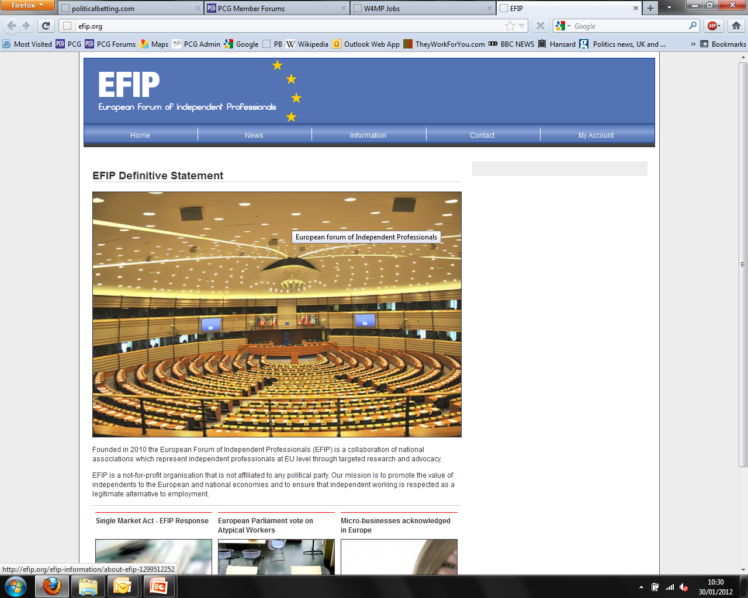

European Influence
PCG works in Europe to represent freelancers. We founded the “European Forum of Independent Professionals”
EFIP has five aims:
  Visibility: to promote international awareness of independent professional life
  Value: to provide better understanding of the value this sector brings to economies
  Resources: sharing of knowledge and statistics, as well as other data of value to independents
  Dialogue: an improved communication between national organisations
  Policy: to provide a conduit for policy matters with EU institutions and other international bodies
Notes:
We’ve defined PCG as the organisation seeking FCR for freelancers
Hub for knowledge and community and a dedicated voice for the freelance workforce
Statement forms the basis of all we do.
Presentation will provide an update as to where we are, what we’re doing and where we are going
This is especially important in the light of recent developments: New Govt, IR35, etc etc
5

Slide 6






Who are we?
EFIP
PCG
(UK)
PZO
(Netherland)
ACTA
(Italy)
Freelance-Europe
(France)
Aprotrad
(France)
FEDIPRO
(Belgium)
ANITI
(Italy)
FEDae (France)
VDSG (Germany)
VCO Global (Ireland)
European Influence
Notes:
6

Slide 7
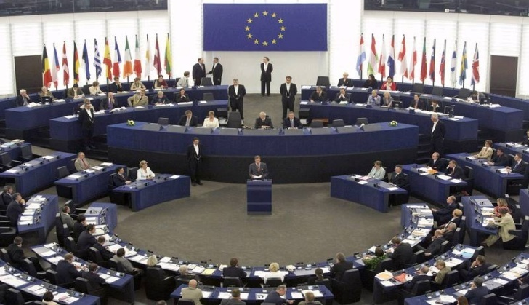
PCG and freelancing in Europe
  Policy affecting freelancers increasingly originates in Brussels
  Definitions of freelancers or independent professionals – are not recognised or as well defined in other European countries as in the UK?
  This is our challenge within Europe- such individuals should be seen as part of the small business landscape
  PCG has been steadily increasing its presence in Europe. We are supporting research into independent professionals across the EU

Slide 8
The future
  The flexible labour market in the UK and Europe will continue to grow, as will the number of freelancers operating within it.
  The value of freelance input/output is increasingly becoming obvious to businesses, large and small. But there is ‘more to do in this area’.
  Recruitment agencies can play an important role in working with the freelance workforce to support and promote their value.....to their clients, when those clients need specialist/short term help
Notes:
8

Slide 9
PCG: The voice of freelancing in the UK
Independents
Independent
Professionals
About PCG
A snapshot
Notes:
UK – Freelancers
Australia – Contractors
Europe – Independents / One person enterprises
9

Slide 10
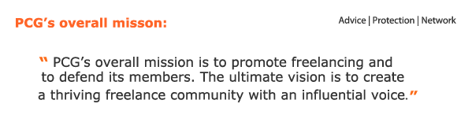
PCG: The voice of freelancing
Independents
Independent
Professionals
  PCG is a not for profit association representing and supporting UK freelancers, contractors and consultants
  We have 21,200 members – represented by a Board of Directors, a Consultative Council and executive team of 19
  We support our members by providing commercial advice and services, and lobbying on their behalf

Slide 11
Who does PCG represent?
  Typically highly skilled knowledge workers
  A real mix of skills: IT, Project Management, Engineering, Creative, Interims, industrial specialists
  One unifying factor is the way they work- independently
  Not employees or employers, but small businesses in their own right supplying skills and services to other businesses
  Our members are the smallest of small businesses: We are “nano-businesses”?
Notes:
11

Slide 12
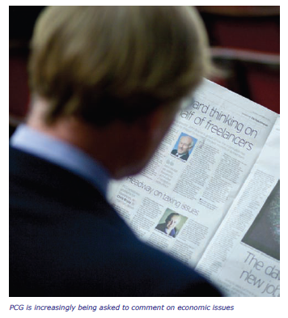
PCG – The voice of freelancing
Often featured on national media
Work closely with Government, MPs and Opposition. [Security Clearance, ICT policy, AWR etc]
Conduct research with leading pollsters, ComRes and academics- Cranfield/Kingston University
Work to influence policymakers in Brussels and beyond
REC/APSCo/CBI link

Slide 13
The value of freelancers
Independents
New research from Cranfield School of Management demonstrates that freelancers play important roles in adding value to the modern UK economy:
    Unlocking Creative Potential
    Enabling Innovation and Competitiveness
    Allowing businesses to always have the ‘A Team’
    Enabling new ‘employment’
Source: Burke. A, 2012, Freelancers at the Heart of the 21st Century Economy : A special report for National Freelancers Day 2012
Notes:
Bullet 1: freelance contractor-entrepreneurs can make a creative input to many businesses in the same time period. Contracting freelancers allows business to separate entrepreneurship from management; particularly in the creative and early start-up stage of development. By contrast successful owner managers usually must stay committed to the same business for many years.
Bullet 2: The freelancer ‘pay as you go’ model allows firms to ring fence and stage the finance on both the trial and roll out of an innovation. It increases the return on investment in innovation. Importantly, the availability of freelancers in Britain encourages some multinationals to base more of their enterprise activities in the UK.
Bullet 3: Rather than try to run with ‘jacks of all trades’ businesses can assemble a team fit for purpose – usually a team comprising a mix of employees and freelancers. Freelancers’ allows business access to expertise that they could not justify using on a longer term non contingent basis.
13

Slide 14

Standing up for freelancers

Slide 15
PCG: The voice of freelancing in the UK
Independents
Independent
Professionals
PCG
Benefits of membership
Notes:
UK – Freelancers
Australia – Contractors
Europe – Independents / One person enterprises
15

Slide 16
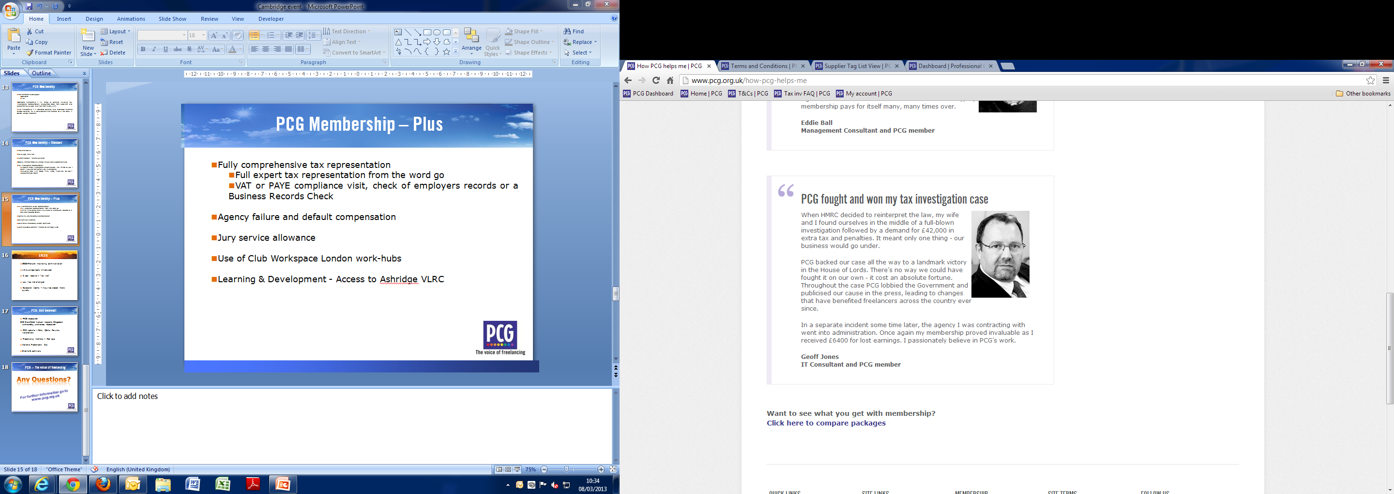
How PCG helps its members
Independents
Independent
Professionals
Notes:
16

Slide 17
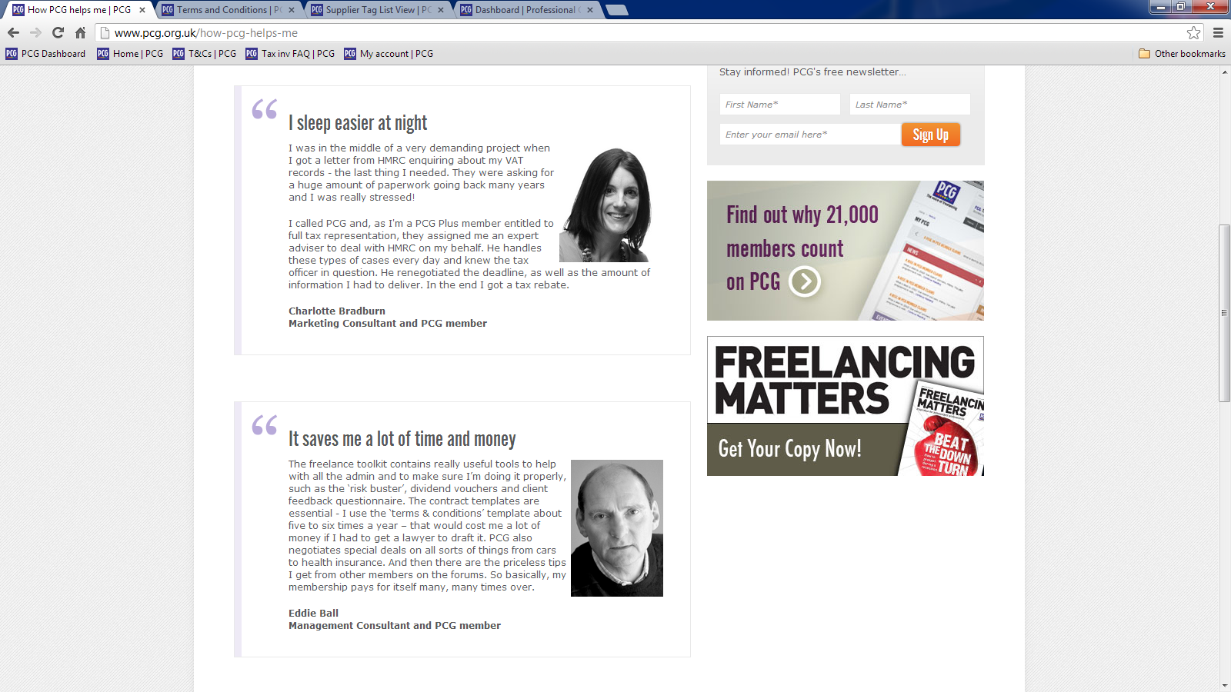
How PCG helps its members
Independents
Independent
Professionals
Notes:
17

Slide 18
PCG Membership
Independents
  Two membership packages:
    Standard Membership
    Full range of benefits including Tax investigation representation, discounted rates from suppliers and access to Tax & Legal helplines. {£120 + VAT}
    Plus Membership
    All standard benefits, plus extended insurance related benefits, skills development and access to hot desks in Central London and other locations {£220 + VAT}
Independent
Professionals
Notes:
UK – Freelancers
Australia – Contractors
Europe – Independents / One person enterprises
18

Slide 19
PCG Membership – Standard
Independents
    Freelance toolkit: Guides, analysis, manuals, templates
    Tax & legal helplines
    Vibrant network: Forums & Events nationwide
    Special member rates on a range of business support services including debt recovery and contract reviews
    Tax investigation representation
      A specialist tax investigation expert to deal with HMRC on your behalf if you are notified of a tax investigation
      Including IR35, VAT, S660, PAYE, NICs, P11D and the Self-Assessment tax return
      Access to Accredited Accountants and other affiliates
      ISO9001 accredited low cost scheme for members
Independent
Professionals
Notes:
19

Slide 20
PCG Membership – Plus
Independents
    Fully comprehensive tax representation
      from the start [brown envelope on door mat]
    VAT or PAYE compliance visit, check of employers records or a Business Records Check
    Agency failure and default compensation
    Jury service allowance
    Use of Club Workspace London work-hubs
    Learning & Development - Access to Ashridge VLRC
    Benchmarking research
Independent
Professionals
Notes:
20

Slide 21



PCG: The voice of freelancing in the UK
Independents
    Guides to:
      Agency Workers Regulations
      IR35
      Pensions and Mortgages
      Credit management and control
      Business Tax and more
    Access to helplines, template contracts, and networking events
    All the latest news affecting freelancers
Independent
Professionals
Notes:
UK – Freelancers
Australia – Contractors
Europe – Independents / One person enterprises
21

Slide 22
PCG Community
    PCG website – Polls, Q&As, Forums, regular newsletters
    Freelancing matters magazine/e-newsletter with ‘app’
    National Freelancers Day…an event to celebrate your contribution to UK plc, now in its 5th year
    Informative Events & seminars nationwide
  You are never alone and without support
Notes:
UK – Freelancers
Australia – Contractors
Europe – Independents / One person enterprises
22

Slide 23
Benchmarks
Independents
  2012-marginally more members in contract [86%]
  Members never out of contract in previous year [69%]
  Members actively considering working abroad [26%]
  Methods of securing contracts….big growth in ‘networking’ [33%-57%] and LinkedIn [11%-31%]
  Day rates are increasing marginally[?]
  Member optimism healthier. 68% now saying outlook staying same or improving over coming year. [LY 49%]
Independent
Professionals
Notes:
UK – Freelancers
Australia – Contractors
Europe – Independents / One person enterprises
23

Slide 24

Thank you
www.pcg.org.uk
John Brazier
Managing Director PCG

